Slide 1
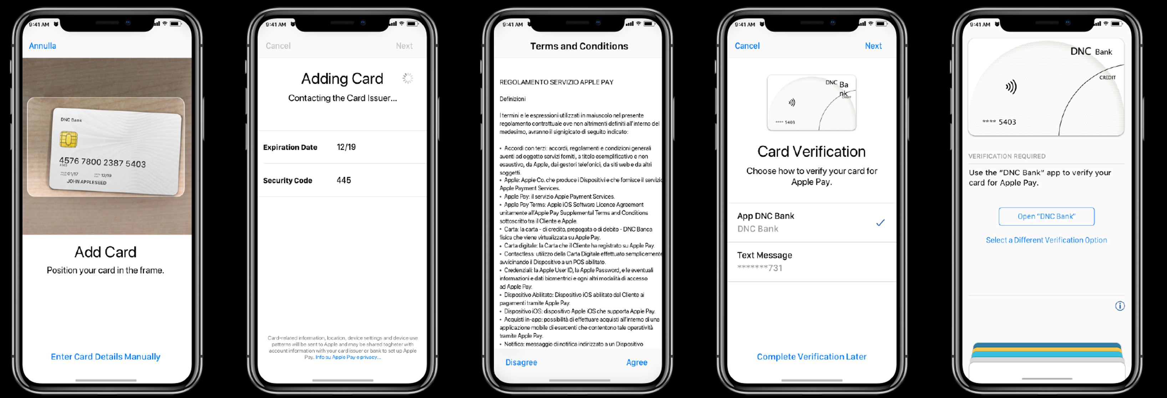
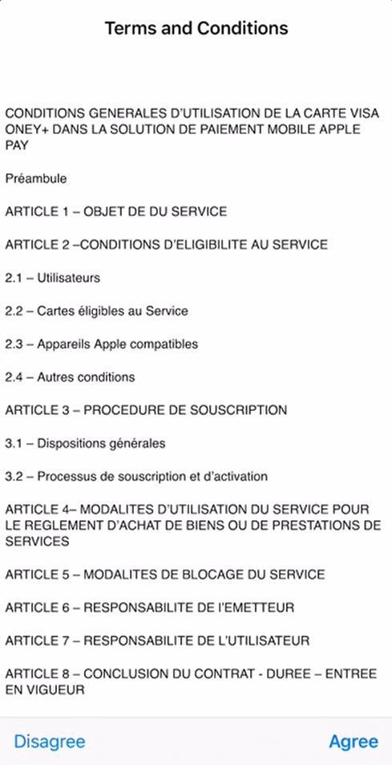
In-App Verification (1/2)
XXXXX

Slide 2
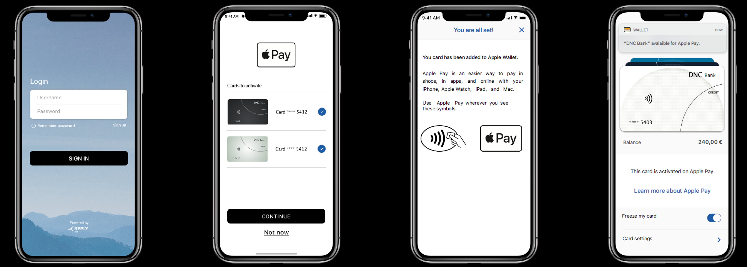

In-App Verification (2/2)
Face ID

Slide 3
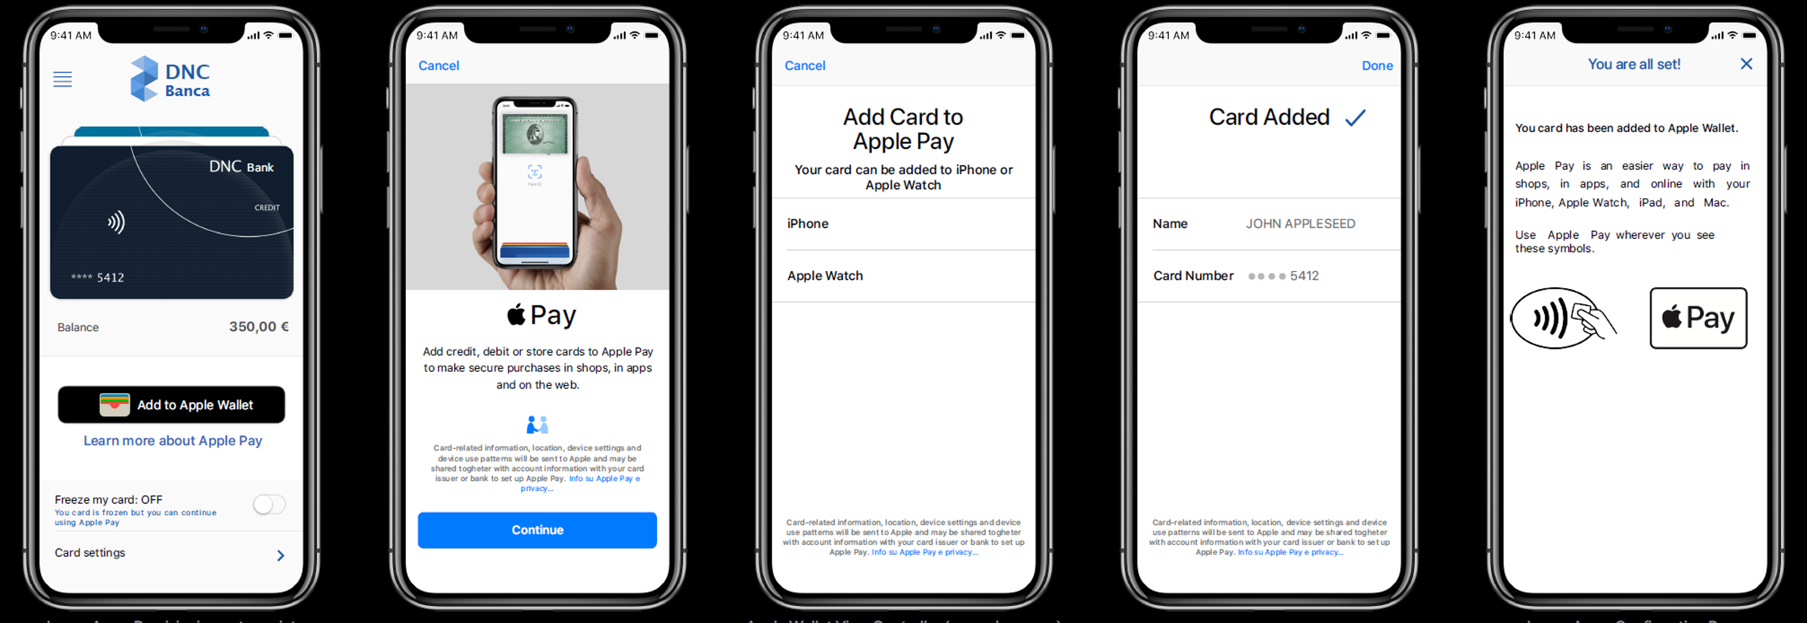
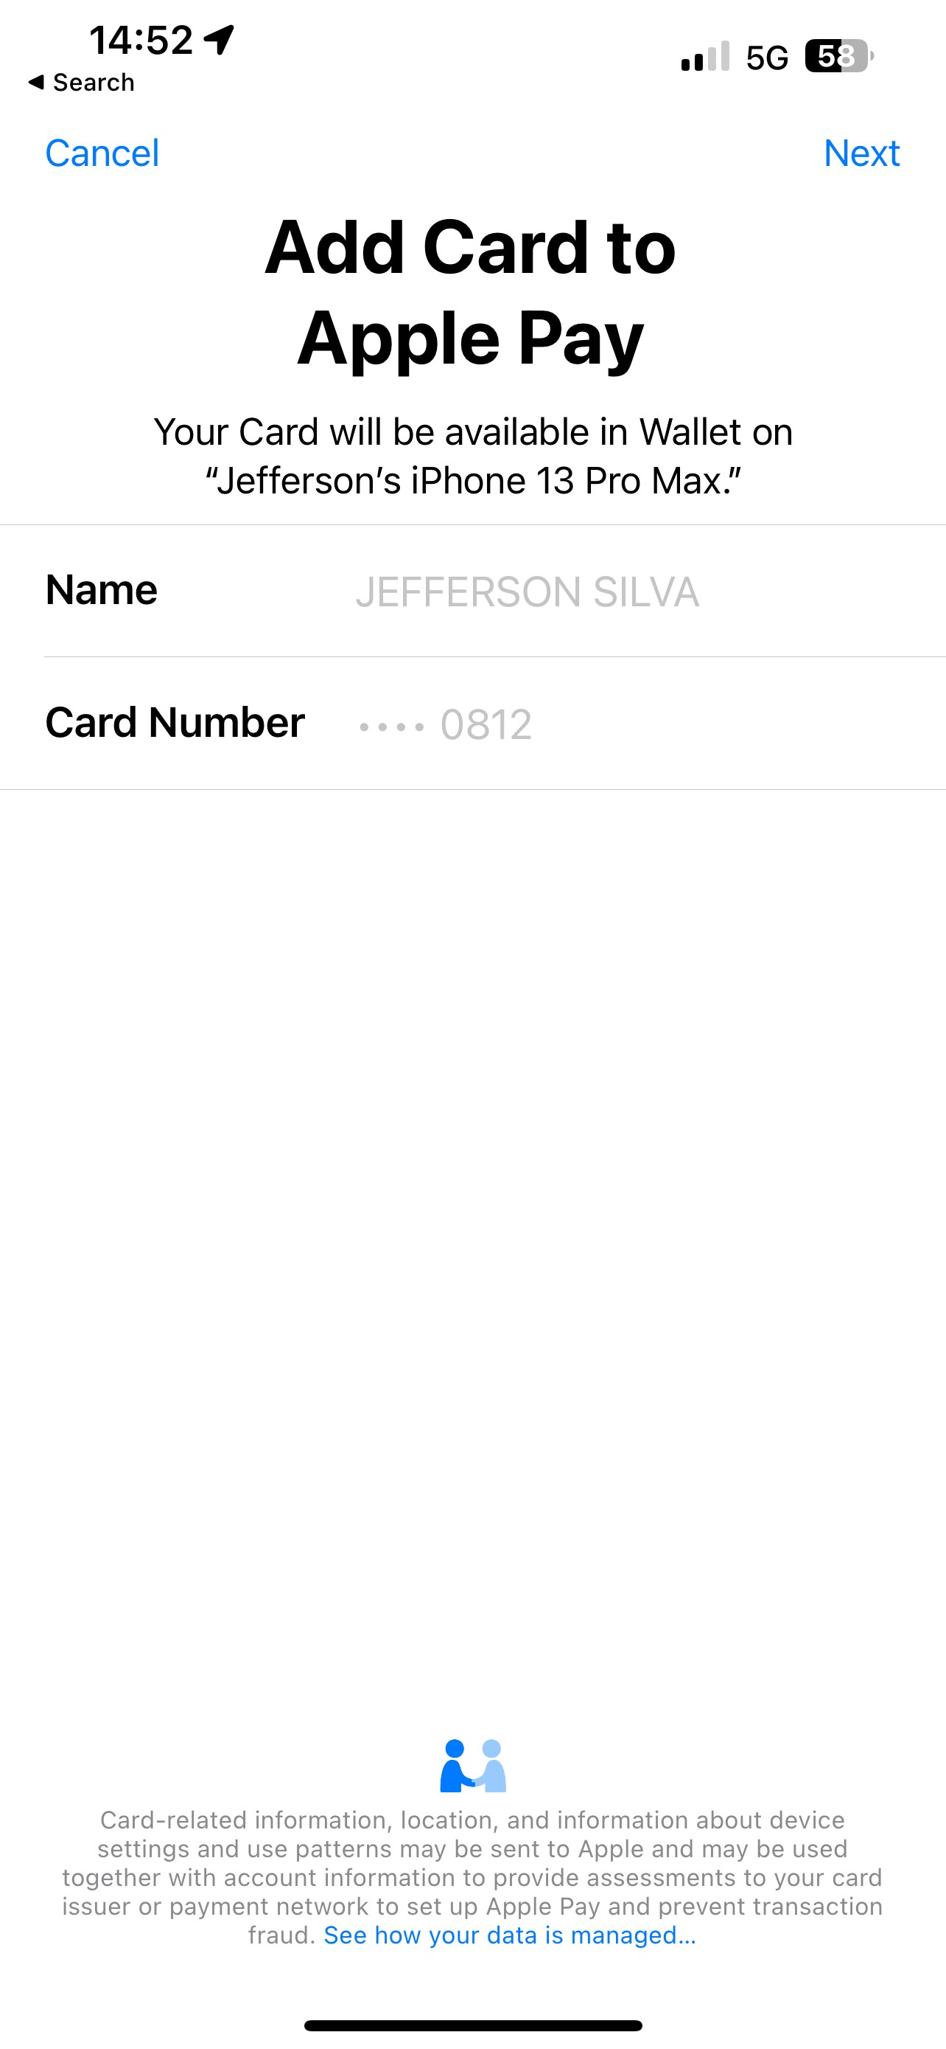
In-App Provisionning
XXXXX
JOHN APPLESEED

Slide 4
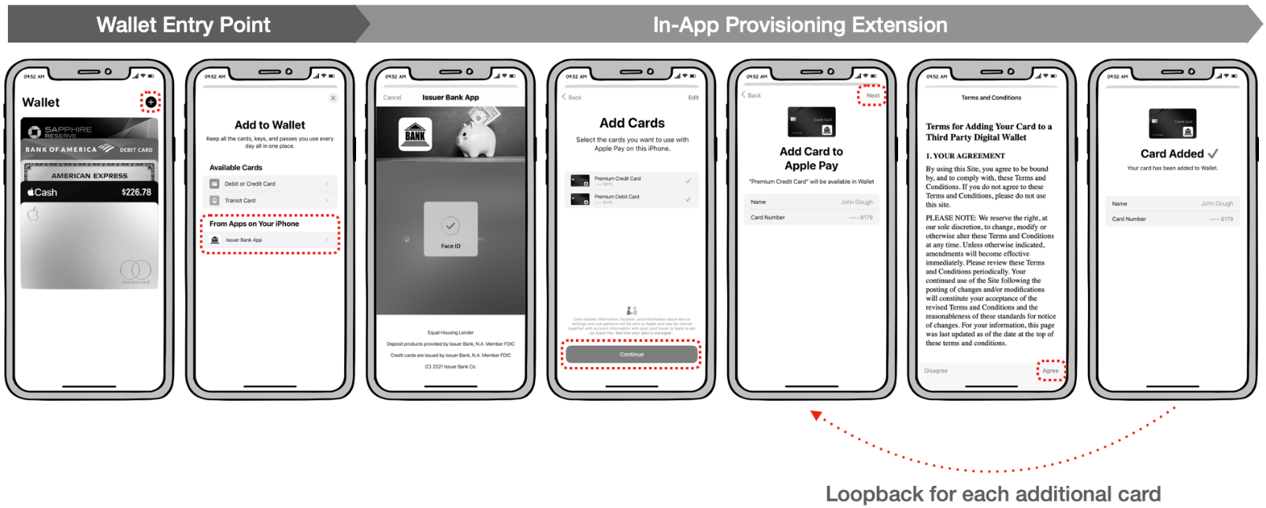
In-App Provisionning Extension
Not supported by Xpollens. Supported by Entrust

